Slide 1
Session 6: SEO-Friendly Content

Slide 2


Importance of SEO-Friendly Content
Free advertising platform
Increased sharing on social media
Wider audience reach
Quality content, high ranking
Minimal bounce rate
Increased visibility, more organic traffic

Slide 3

Creating Effective SEO Content Strategy
List long-tail keywords based on topics
Build pages for each topic
List topics
Make a link-
building plan
Set up a blogging schedule
Set up a blog
Compress media files
Follow Latest SEO guidelines
Track content

Slide 4

Components of SEO Content
Title tag Page URL
Meta Descriptions H1 tags
Keywords Images
Internal and external links

Slide 5
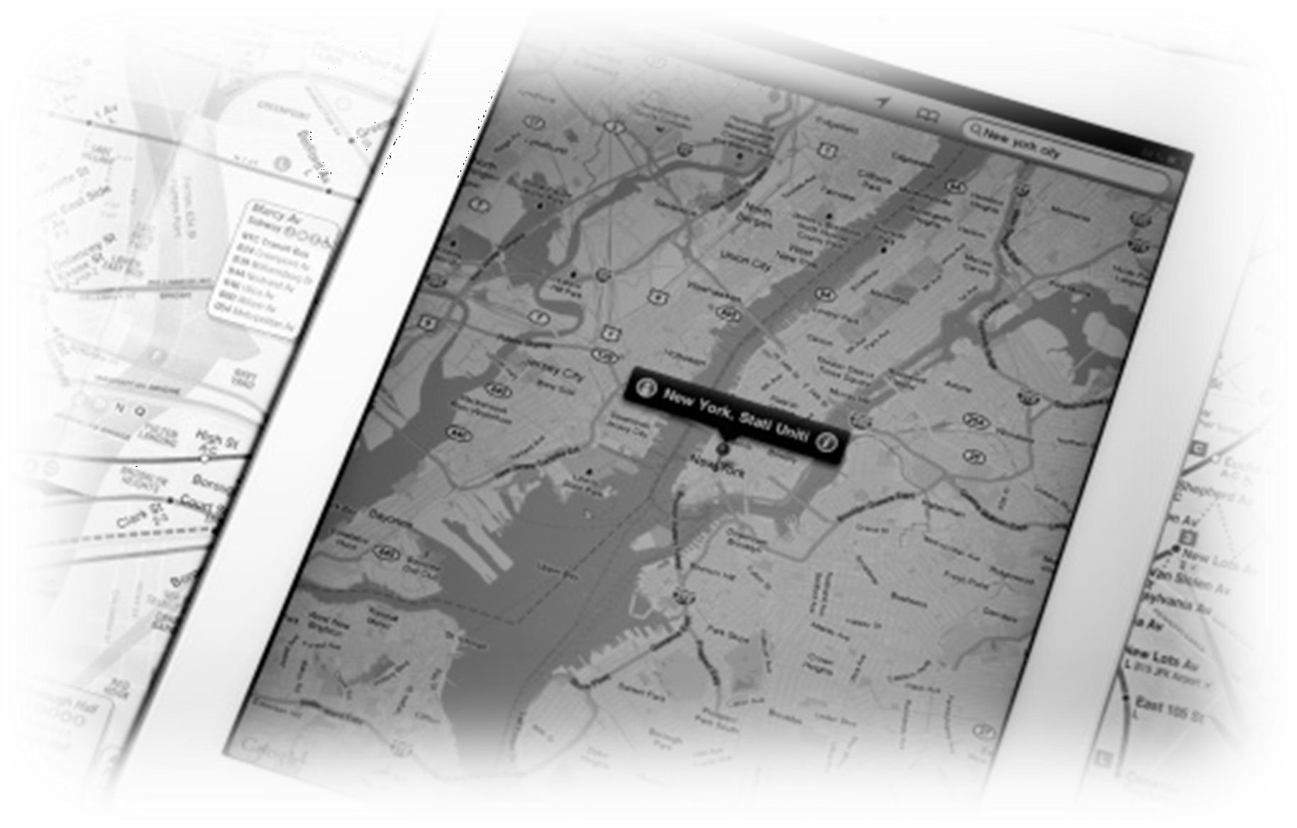
Importance of Local SEO Content
~1.6 billion Google searches daily
~1.5 billion physical visits based on searches
90% local searches = physical purchase
500% increase in ‘near me’ and ‘buy now’ searches
50% ‘near me’ users visit store
90% users depend on positive online reviews
86% users use Google Maps to explore local businesses

Slide 6
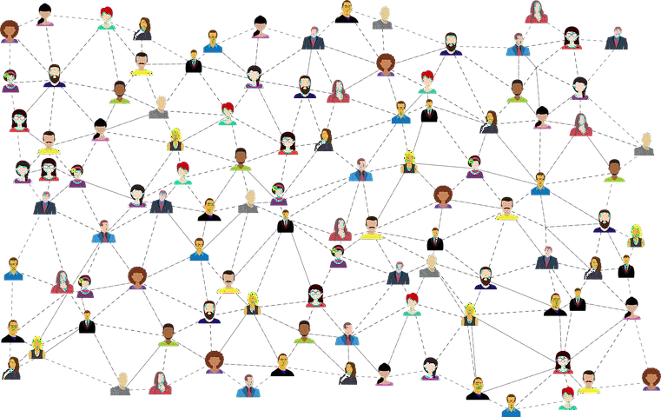
Popular Social Networking Media
Links published on social media are back-links that influence SEO and rank.
Wikipedia
Reddit
Twitter
Free Social Media Platforms
Pinterest
LinkedIn
Facebook
Premium platforms: Instagram for Business and YouTube Premium

